Slide 1
CSC406: Net-centric Computing Introduction to Web Development
F. U. Ambursa

Slide 2
Course Outline
Introduction to WWW
Structuring and Formatting with HTML
Styling with CSS

Slide 3
Learning Outcomes
In this lecture, you will learn about:
Overview of the Internet
Introduction to the World Wide Web
Writing a basic HTML web page

Slide 4

The Internet vs. The Web
The Internet is a worldwide network of computers all attached in a global networking scheme.
Notes:
Internet:
Definition: The Internet is a global network that connects millions of private, public, academic, business, and government networks. It is a vast infrastructure that facilitates the exchange of information and communication globally.
Characteristics:
Network of Networks: The Internet is a massive network made up of smaller interconnected networks.
Protocols: It operates based on a set of protocols (like TCP/IP) that define how data is transmitted and received.
Infrastructure: It includes physical infrastructure such as cables, routers, and servers.
The history of the Internet is a complex and fascinating journey that spans several decades. Here's a brief overview:
1960s: The Precursors:
The origins of the Internet can be traced back to the 1960s with the development of ARPANET (Advanced Research Projects Agency Network) by the U.S. Department of Defense's ARPA (Advanced Research Projects Agency). ARPANET was the first network to use the packet-switching technique, dividing data into packets for efficient transmission.
1970s: TCP/IP Protocols:
In the early 1970s, the development of the Transmission Control Protocol (TCP) and the Internet Protocol (IP) laid the foundation for the modern Internet. These protocols became the standard for data transmission, providing a common language for diverse computer networks to communicate.
1980s: Expansion and Domain Name System (DNS):
The 1980s saw the expansion of the Internet beyond military and academic circles to the general public. The Domain Name System (DNS) was introduced to simplify the addressing of websites, replacing numeric IP addresses with human-readable domain names.
1990s: World Wide Web (WWW) and Commercialization:
Tim Berners-Lee developed the World Wide Web in 1990, introducing concepts like HTML (Hypertext Markup Language) and HTTP (Hypertext Transfer Protocol). This made the Internet more accessible and user-friendly.
The 1990s also witnessed the commercialization of the Internet, with the rise of commercial ISPs (Internet Service Providers) and the launch of graphical web browsers like Netscape.
2000s: Broadband and Social Media:
The 2000s saw the widespread adoption of broadband internet, providing faster and more reliable connections.
Social media platforms like Facebook, Twitter, and YouTube emerged, changing the way people communicated and shared information.
2010s: Mobile Internet and the Internet of Things (IoT):
Mobile internet usage surged with the proliferation of smartphones and tablets.
The Internet of Things (IoT) gained prominence as everyday devices became connected to the internet, enabling data exchange and automation.
2020s: Continued Evolution:
The Internet continues to evolve, with advancements in technologies like 5G, artificial intelligence, and increased focus on cybersecurity and privacy.
Throughout its history, the Internet has become an integral part of modern life, influencing communication, commerce, education, and various other aspects of society on a global scale.

Slide 5
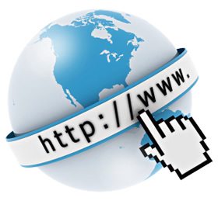
The Internet vs. The Web
The World Wide Web is a collection of electronic documents (containing text, graphics, and even multimedia contents) that are linked to one another via hyperlinks.
Notes:
Web (World Wide Web):
Definition: The Web, or World Wide Web, is a system of interlinked hypertext documents and multimedia content that are accessed via the Internet. It is an information space where documents and resources are identified by Uniform Resource Locators (URLs).
Characteristics:
Hypertext: The content on the Web is often in the form of hypertext, allowing users to navigate between documents by clicking on links.
Web Browsers: Access to the Web is typically done through web browsers like Chrome, Firefox, Safari, etc.
HTTP/HTTPS: Communication on the Web is facilitated by the Hypertext Transfer Protocol (HTTP) or its secure version, HTTPS.
In summary, the Internet is the underlying network infrastructure, while the Web is a specific way of accessing and interacting with information over that network. The Internet supports various services beyond the Web, such as email, file transfer (FTP), and more. The Web is just one application that operates on top of the Internet.
From the above I can say that "without the Internet, there will be no web". Is the opposite also true?
The statement "Without the Internet, there will be no web" is accurate. The World Wide Web (Web) relies on the underlying infrastructure provided by the Internet to function. In other words, the Web is a service that operates on top of the Internet.
On the other hand, the opposite is not true. The Internet is a much broader concept that encompasses various services and communication protocols beyond the Web. While the Web is a significant and widely used application on the Internet, the Internet itself supports other services like email, online gaming, file transfer, video conferencing, and more.
In essence, the Web is just one part of the larger ecosystem of the Internet. The Internet provides the foundation, and the Web is a specific way of utilizing that foundation to share and access information.

Slide 6
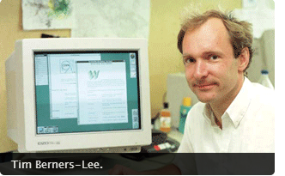
History of the Web
Tim Berners-Lee invented the World Wide Web in 1989, about 20 years after the first connection was established over what is today known as the Internet
At that time, Tim was a software engineer at CERN, the large particle physics laboratory near Geneva, Switzerland. He is currently a professor at the Department of Computer Science University of Oxford AND MIT.
Notes:
Tim Berners-Lee, a British scientist working at CERN (European Organization for Nuclear Research), proposed the concept of the World Wide Web in 1989. His proposal outlined a system for sharing and accessing information through a hypertext system.
The terms "Web 1.0," "Web 2.0," and "Web 3.0" are used to describe different phases in the evolution of the World Wide Web, each characterized by distinct trends and technological advancements.
Web 1.0:
Era: Late 1980s to early 2000s.
Characteristics:
Static Content: Websites were primarily informational and presented static content. Interactivity was limited.
Read-Only Web: Users were consumers of information but had little ability to contribute or interact with websites.
Centralized Control: Content creation and publishing were controlled by a few entities. It was more of a one-way communication model.
Web 2.0:
Era: Early 2000s onwards (commonly associated with the early to mid-2000s).
Characteristics:
User-Generated Content: The web became more interactive, allowing users to generate and share content. Social media platforms, blogs, and wikis emerged.
Collaboration and Participation: Web 2.0 encouraged collaboration and user participation. Social networking, commenting, and rating systems became widespread.
Dynamic and Responsive Design: Websites became more dynamic with the use of AJAX (Asynchronous JavaScript and XML) for seamless and asynchronous data retrieval. Responsive design principles gained importance.
Web 3.0:
Era: The concept of Web 3.0 is still evolving, and there isn't a specific timeframe associated with it. It's often discussed in the context of ongoing and future developments.
Characteristics (Conceptual):
Semantic Web: Focus on making data more understandable by machines. This involves adding meaning to data, allowing machines to comprehend and interpret information more intelligently.
Decentralization: Emphasis on decentralized technologies, including blockchain and decentralized applications (DApps). This is aimed at reducing reliance on central authorities.
Artificial Intelligence (AI): Integration of AI technologies to enhance data analysis, personalization, and automation.
Personalization and Interconnectivity: Improved personalization of content and services based on user behavior and preferences. Increased interconnectivity between various online platforms and services.
It's important to note that the distinctions between these phases are not strict, and there is ongoing debate about the precise definitions and timelines. The transition from one "web" to another is more of a gradual evolution, and many elements of Web 2.0 continue to be relevant in the current web landscape. Web 3.0 is still a vision and an area of active exploration in terms of technologies and standards.

Slide 7
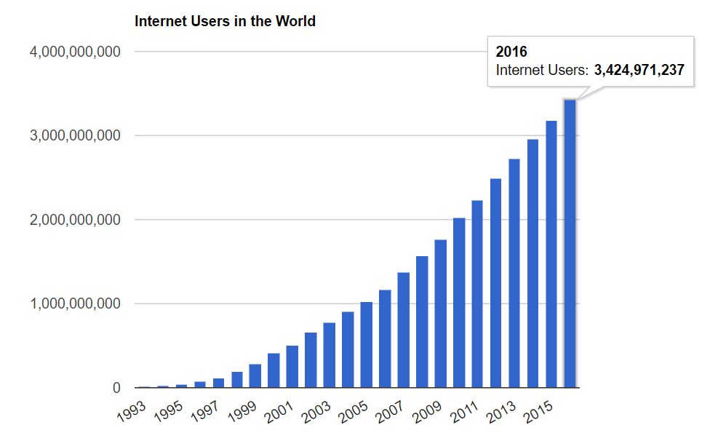
Growth of Internet (www.internetlivestats.com)
Notes:
As at June 30th, 2022 we have an estimated 5,385,798,406 number of people on the internet.

Slide 8
Fundamental technologies of WWW
WEB BROWSER: A web browser is a piece of software that lets you navigate to and display web pages.
WEB CLIENT: Requests and receives WEB PAGES from server.
WEB SERVER: Receives and responds to request for WEB PAGES by clients
HTML: HyperText Markup Language. The publishing format for the Web, including the ability to format documents and link to other documents and resources.
HTTP (Hypertext Transfer Protocol): allows for the retrieval of linked resources from across the Web
URL (Uniform Resource Locator): A kind of “address” that is unique to each resource on the Web.

Slide 9
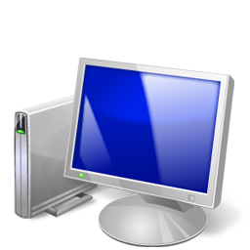
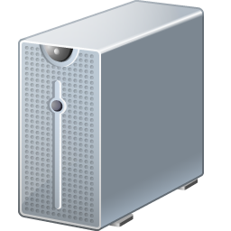

How the Web Works?
WWW use classical client / server architecture
HTTP is text-based request-response protocol
HTTP
Page request
HTTP
Server response
Client running a Web Browser
Server running Web Server Software (IIS, Apache, etc.)
Notes:
The World Wide Web operates on a client-server model, where clients (typically web browsers) communicate with servers to request and receive web pages and other resources. Here's a step-by-step overview of how the web works:
User Input and URL:
A user inputs a Uniform Resource Locator (URL) into a web browser. The URL specifies the protocol (e.g., HTTP or HTTPS), the domain name (e.g., www.example.com), and the path to the resource (e.g., /page).
Domain Name System (DNS) Resolution:
The browser sends a Domain Name System (DNS) request to translate the human-readable domain name into an IP address. DNS servers respond with the IP address associated with the requested domain.
Initiating a Connection:
The browser establishes a connection with the web server using the IP address obtained from the DNS. If the website uses HTTPS, a secure connection is established using TLS/SSL.
HTTP Request:
The browser sends an HTTP request to the web server, specifying the resource it wants (e.g., a web page, image, or stylesheet). The request includes information like the method (GET, POST), headers, and sometimes data.
Web Server Processing:
The web server receives the HTTP request and processes it. It retrieves the requested resource from its file system or generates it dynamically using server-side technologies like PHP, Python, or Node.js.
Server Response:
The server sends back an HTTP response to the browser. The response includes a status code (indicating success or failure), headers (providing metadata), and the actual content (e.g., HTML, images, or other files).
Rendering the Web Page:
The browser receives the response and interprets the content. If the resource is an HTML document, the browser parses the HTML, renders the structure using CSS, and executes any JavaScript. This process creates the visual representation of the web page.
Downloading Additional Resources:
The web page may contain references to additional resources, such as images, stylesheets, or scripts. The browser sends additional requests for these resources, and the server responds accordingly.
Rendering Complete:
The browser combines all the downloaded resources to render the complete web page. The user can interact with the page, click on links, submit forms, and trigger additional requests.
Continued Interaction:
As the user interacts with the web page, the browser may send additional requests to the server for dynamic content or updates. This allows for a dynamic and interactive user experience.
This process repeats each time a user requests a new web page or interacts with elements on a page. The underlying technologies and standards, such as HTML, CSS, JavaScript, HTTP, and DNS, work together to make the World Wide Web functional and accessible.

Slide 10
Web Client
Connected to the Internet when needed
Usually runs web browser (client) software such as Google Chrome, Opera or Firefox
Uses HTTP (Hypertext Transfer Protocol)
Requests web pages from server
Receives web pages and files from server

Slide 11
Web Server
Continually connected to the Internet
Runs web server software (such as Apache or Internet Information Server)
Uses HTTP (Hypertext Transfer Protocol)
Receives request for the web page
Responds to request and transmits status code, web page, and associated files

Slide 12
HTTP Hypertext Transfer Protocol
A set of rules for exchanging files such as text, graphic images, sound, video, and other multimedia files on the Web.
Web browsers send HTTP requests for web pages and their associated files.
Web servers send HTTP responses back to the web browsers.
HTTP Request
HTTP Response

Slide 13
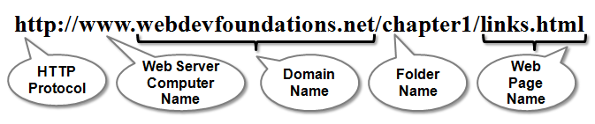
URL Uniform Resource Locator
URL
Represents the address of a resource on the Internet.

Slide 14
What is a Web Page?
Web page is a document written in HTML
HTML – Hyper Text Markup Language
A notation for describing
document structure (semantic markup)
formatting (presentation markup)
Looks like:
A Microsoft Word document
The markup tags provide information about the page content structure

Slide 15
Creating HTML Pages
An HTML file must have an .htm or .html file extension
HTML files can be created with text editors:
NotePad, NotePad ++, PSPad
Or more advanced HTML editors:
Macromedia Dreamweaver
Netscape Composer
Microsoft Visual Studio

Slide 16
Creating HTML using notepad
Step 1: Go to my computer
Step 2: double click c: / drive
Step 3: create a new folder and name it web programming
Step 4: Open notepad in accessories
Step 5: Type your html code into your notepad
Step 6: In the notepad go to file, click save as.
Step 7: In the save as dialog box, move to the location of web programming folder you initially created.
Step 8: type the name of your document in the file name box with the extension .html. Click save

Slide 17
Running html in the browser
Step 1: go to my computer
Step 2: double click c:/ drive
Step 3: go to web programming folder
Step 4: find the document and double click it.
the html document will open with your default browser.

Slide 18
Creating a simple web page
To start - Create a Folder:
You’ll find it helpful to create folders to organize your files as you develop the web pages in this course and create your own websites.
To create a new folder with Windows:
Launch Windows Explorer (either press the Windows key or select Start > All Programs > Accessories > Windows Explorer), and navigate to the location where you would like to create the new folder, such as My Documents or your C: drive.
Right Click > New > Folder.
To rename the New Folder, right-click on it, select Rename from the context menu, type in the new name, e.g mynameWebpages and press the Enter key.

Slide 19
Creating a simple web page
Launch Notepad or another text editor and type in the following code.
<!DOCTYPE html>
<head>
<title>My First Web Page</title>
</head>
<body>
<h1>Welcome!</h1>
<p>Hi, I am __________, with Registration number _________. </p> <p>I think I’ll enjoy web programming.</p>
</body>
</html>
Save your Document as “myFirstWebPage.html”
NOTE: the quotations marks are also part of the file name

